Slide 1
Constructor in Java
In Java, constructor is a block of codes similar to method. It is called when an instance of object is created and memory is allocated for the object.
It is a special type of method which is used to initialize the object.

Slide 2
Rules for creating java constructor There are basically two rules defined for the constructor. Constructor name must be same as its class name Constructor must have no return type

Slide 3
Types of java constructors
There are two types of constructors in java:
Default constructor
Parameterized constructor

Slide 4
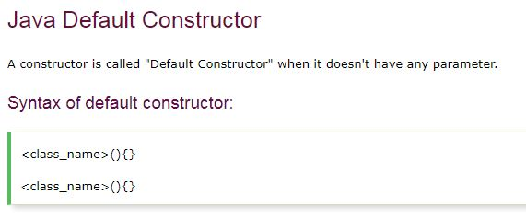

Slide 5
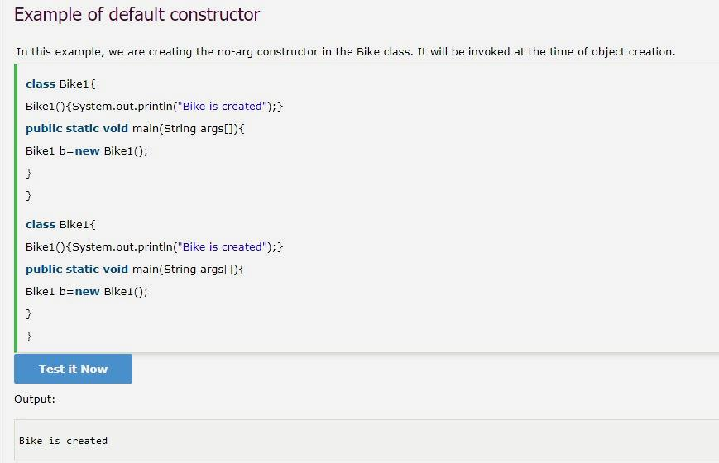

Slide 6
Q) What is the purpose of default constructor?
Default constructor is used to provide the default values to the object like 0, null etc. depending on the type.

Slide 7
Java parameterized constructor
A constructor which has a specific number of parameters is called parameterized constructor.
Why use parameterized constructor?
Parameterized constructor is used to provide different values to the distinct objects.

Slide 8
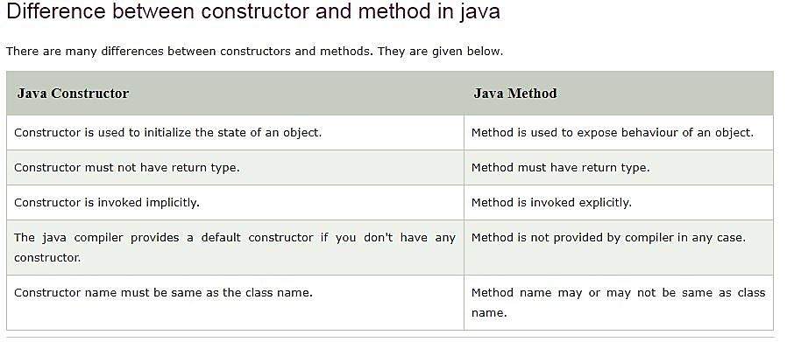

Slide 9
Q) Does constructor return any value? Ans: yes, that is current class instance (You cannot use return type yet it returns a value).

Slide 10
Can constructor perform other tasks instead of initialization? Yes, like object creation, starting a thread, calling method etc. You can perform any operation in the constructor as you perform in the method.

